Slide 1
Cs-381 Software Engineering
Course Instructor: Dr. Shazia Arshad
Notes:
Welcome to all of you in this course. I am Dr. Shazia Arshad. I will be your instructor for this course.

Slide 2
Software Verification and Validation
Verification:
Does the product meet system specifications?
Have you built the product right?
Validation:
Does the product meet user expectations?
Have you built the right product?

Slide 3
Software testing objective
The correct approach to testing a scientific theory is not to try to verify it, but to seek to refute the theory. That is to prove that it has errors. (Popper 1965)
The goal of testing is to expose latent defects in a software system before it is put to use.
A software tester tries to break the system. The objective is to show the presence of a defect not the absence of it.
Testing cannot show the absence of a defect. It only increases your confidence in the software.
This is because exhaustive testing of software is not possible – it is simply too expansive and needs virtually infinite resources.

Slide 4
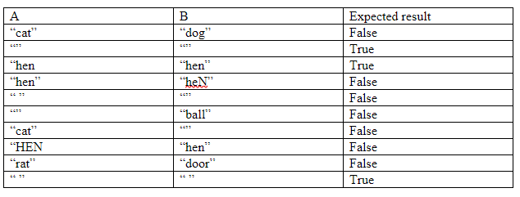
Limitations of testing
Possible combinatons of inputs for equality of strings.

Slide 5
Testing limitations
In order to prove that a formula or hypothesis is incorrect all you have to do to show only one example in which you prove that the formula or theorem is not working.
On the other hand, million of examples can be developed to support the hypothesis but this will not prove that it is correct.
You cannot test a program completely because: o the domain of the possible inputs is too large to test. o there are too many possible paths through the program to test.

Slide 6
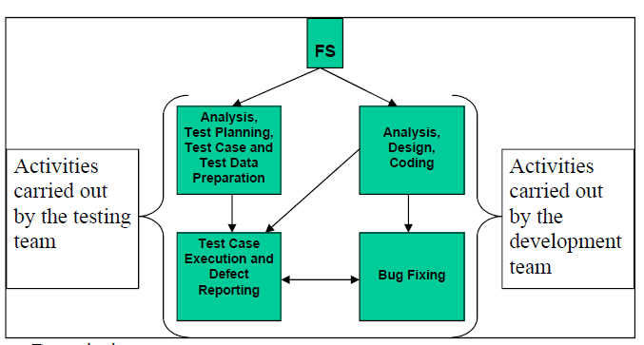
Testing vs Development
Testing demands grip over the domain and application functionality
Writing test cases demand scenario building capabilities
Tester needs to figure out loose points

Slide 7
Description
Functional specification document is the starting point, base document for both testing and the development.
Development team is involved into the analysis, design and coding activities.
Whereas, testing team too is busy in analysis of requirements, for test planning, test cases and test data generation.
System comes into testing after development is completed.
Test cases are executed with test data and actual results (application behavior) are compared with the expected results,
Upon discovering defects, tester generates the bug report and sends it to the development team for fixing.
Development team runs the scenario as described in the bug report and try to reproduce the defect.
If the defect is reproduced in the development environment, the development team identifies the root cause, fixes it and sends the patch to the testing team along with a bug resolution report.
Testing team incorporates the fix (checking in), runs the same test case/scenario again and verifies the fix.
If problem does not appear again testing team closes down the defect, otherwise, it is reported again.

Slide 8
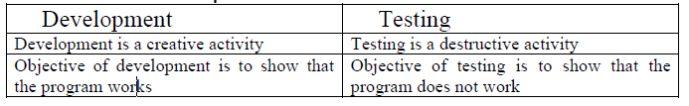
Developer and tester

Slide 9
WHY TESTING??
To fix as many errors as possible before the software is put to use
Arift exists between the development and the testing teams
The client may ask to fix all the defects (free of cost)

Slide 10

TIME TO THINK
Study Testing Rules

